Slide 1


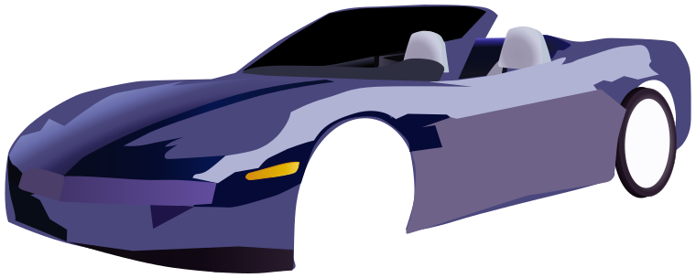
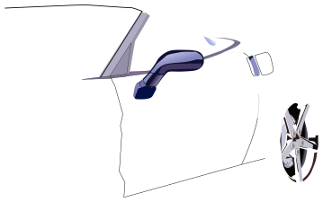
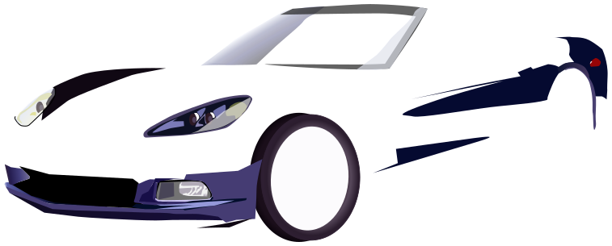



Digital Portfolio
STUDENT NAME: ZACHARIAH ROY REGISTER NO : 24H221 DEPARTMENT: BCA COLLEGE: AM JAIN COLLEGE
1

Slide 2
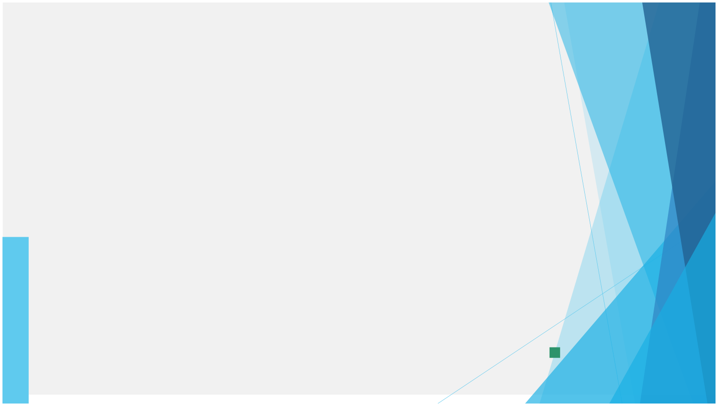

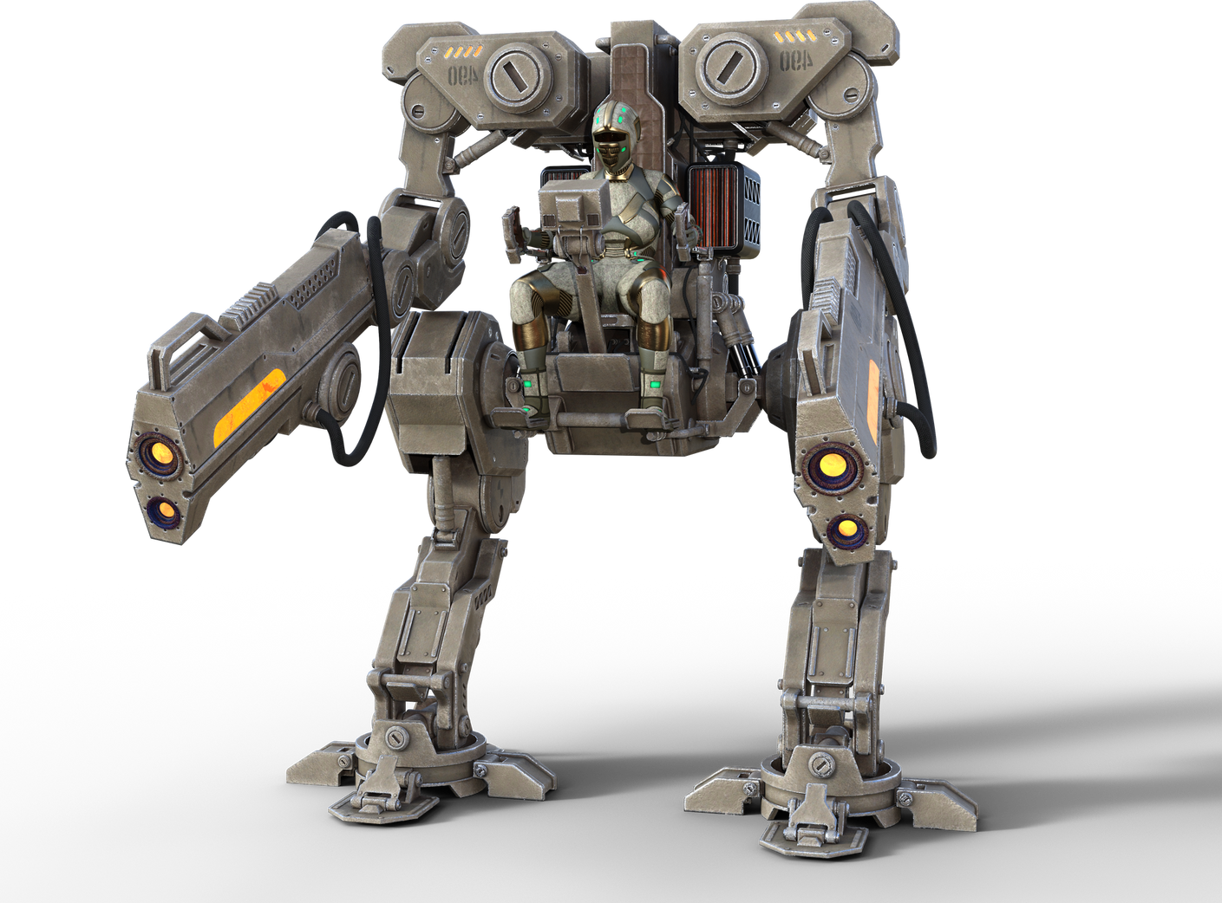
Digital Potfolio
2

Slide 3

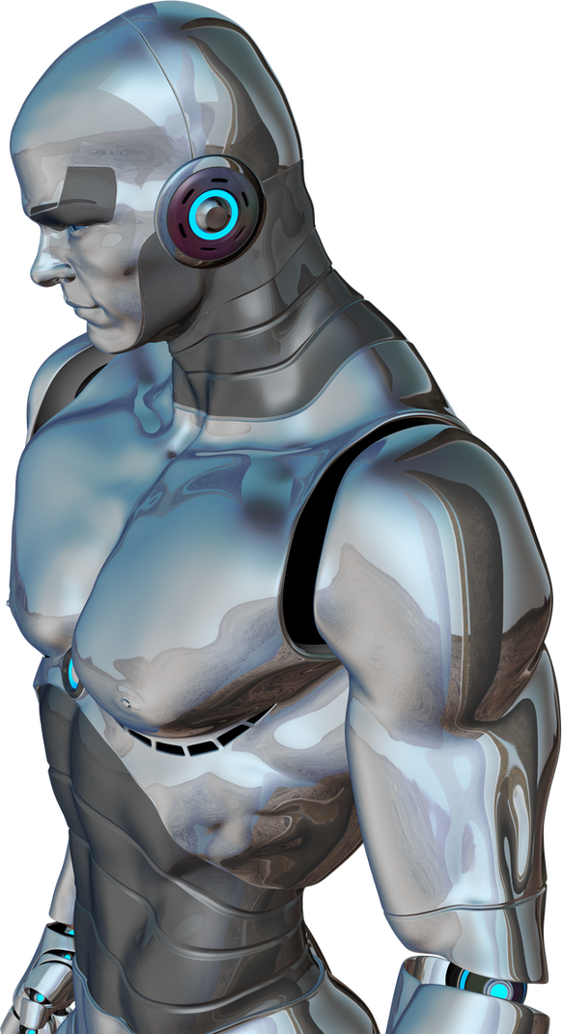

AGENDA
1.Problem Statement 2.Project Overview 3.End Users 4.Tools and
Technologies
5.Portfolio design and
Layout
6.Features and
Functionality
7.Results and
Screenshots
8.Conclusion 9.Github Link
3/21/2024 Annual Review
3

Slide 4


PROBLEM
STATEMENT
Traditional resumes and static portfolios fail to showcase a developer’s skills, creativity, and interactive capabilities effectively. There is a need for a modern, responsive, and visually engaging digital portfolio that highlights technical expertise, projects, and contact information while providing an interactive user experience
4

Slide 5

PROJECT OVERVIEW
This is a personal portfolio website designed to present Zachariah Roy’s profile, skills, and projects. It provides a responsive, visually appealing neon-themed design, includes sections like About, Skills, Projects, Instagram, and Contact, and demonstrates frontend development capabilities with HTML, CSS, and JavaScript.
5

Slide 6


WHO ARE THE END USERS?
Recruiters and hiring managers Potential clients Collaborators and peers in the tech/design field General audience interested in Zachariah’s work
6

Slide 7
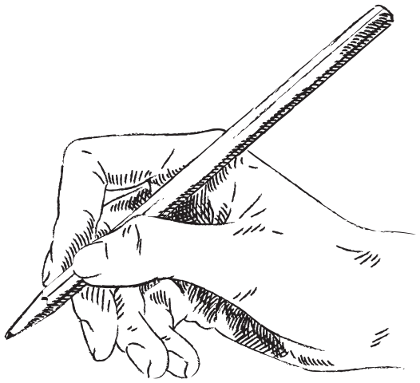
TOOLS AND TECHNIQUES
HTML5 – for content structure CSS3 – for styling and responsive design JavaScript (ES6+) – for interactivity Font Awesome – for icons Responsive Web Design principles – for mobile-friendly layouts
7

Slide 8

POTFOLIO DESIGN AND LAYOUT
Theme: Neon modern aesthetic with glowing effects Sections: Header & Navigation (sticky menu with links) Hero Section (intro with CTA button) About Section (personal introduction with image) Skills Section (grid of skills with hover animations) Projects Section (cards with images, descriptions, and links) Instagram Section (social profile highlight) Contact Section (form + contact info) Footer (social media links) Layout: Grid and flexbox-based, fully responsive
8

Slide 9
FEATURES AND FUNCTIONALITY
Smooth scrolling navigation Interactive skill highlights with neon glow effect Responsive design for desktop and mobile Project showcase with hover animations Instagram profile integration with CTA button Contact form with validation and submission alert Mobile menu toggle (hamburger menu)

Slide 10

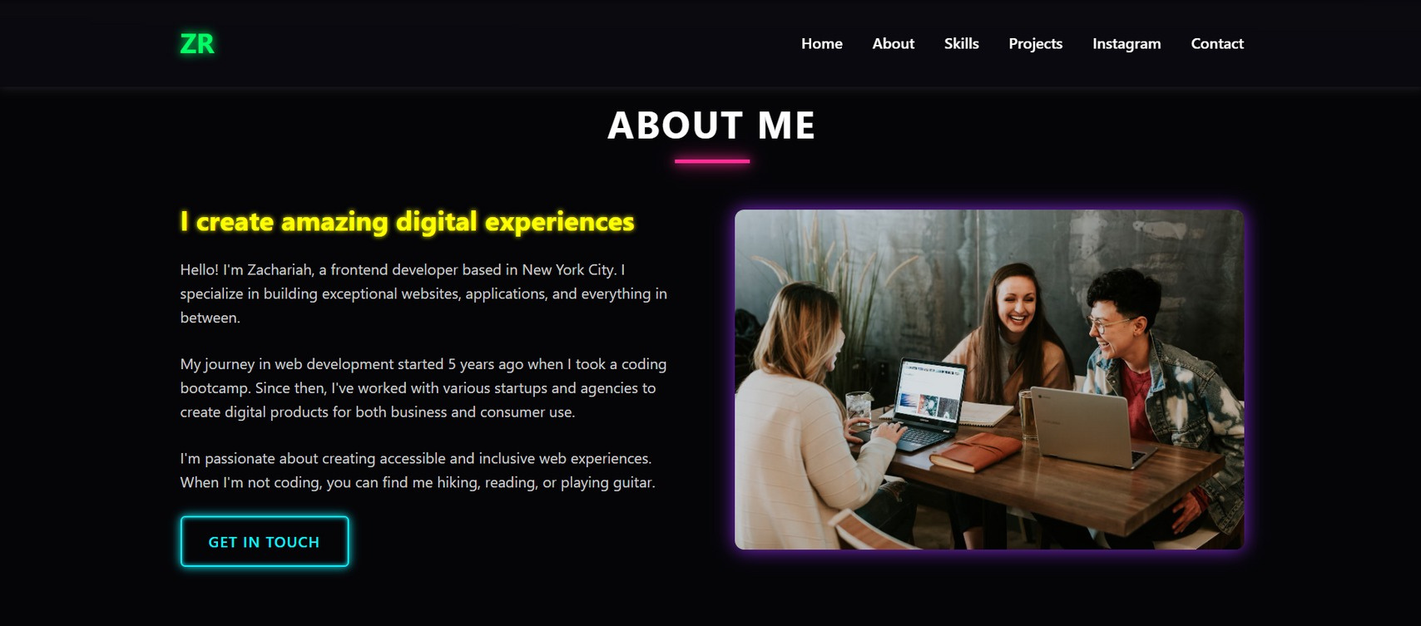
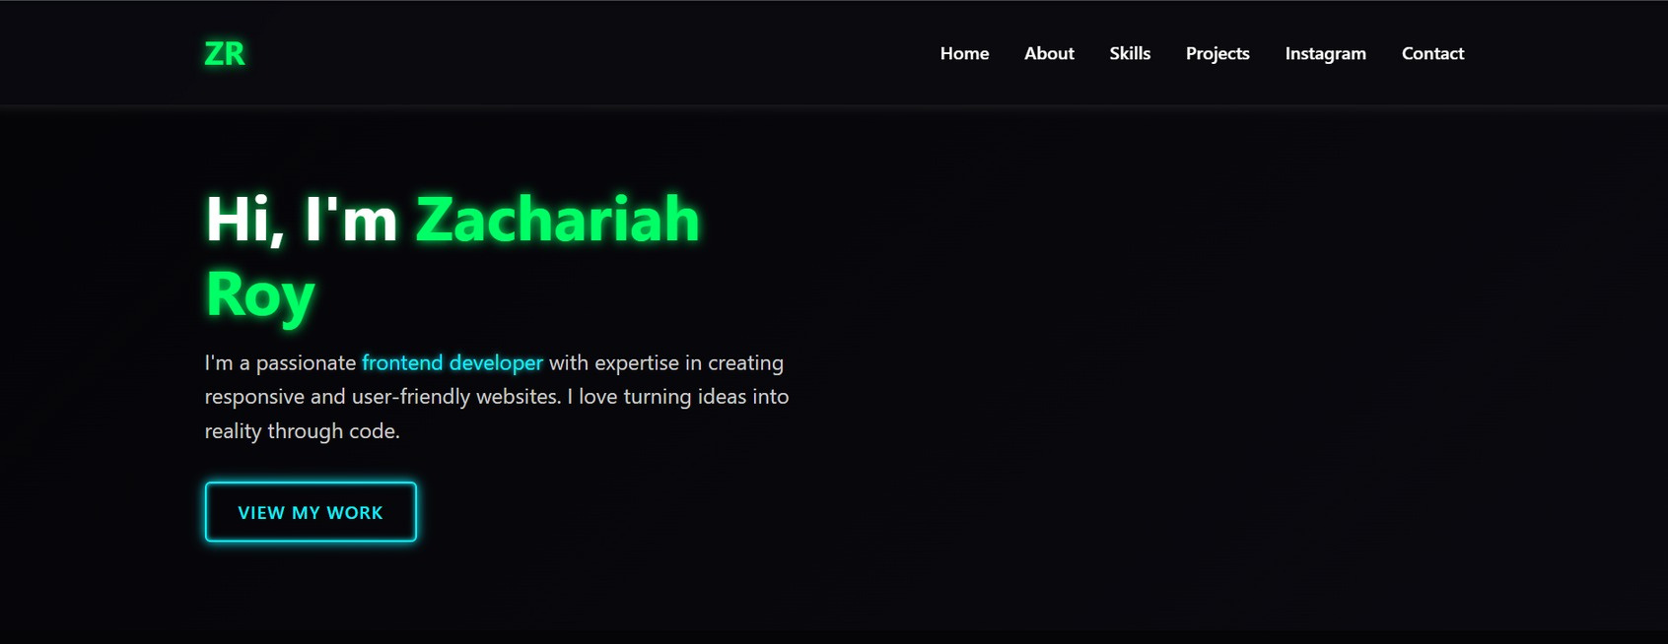
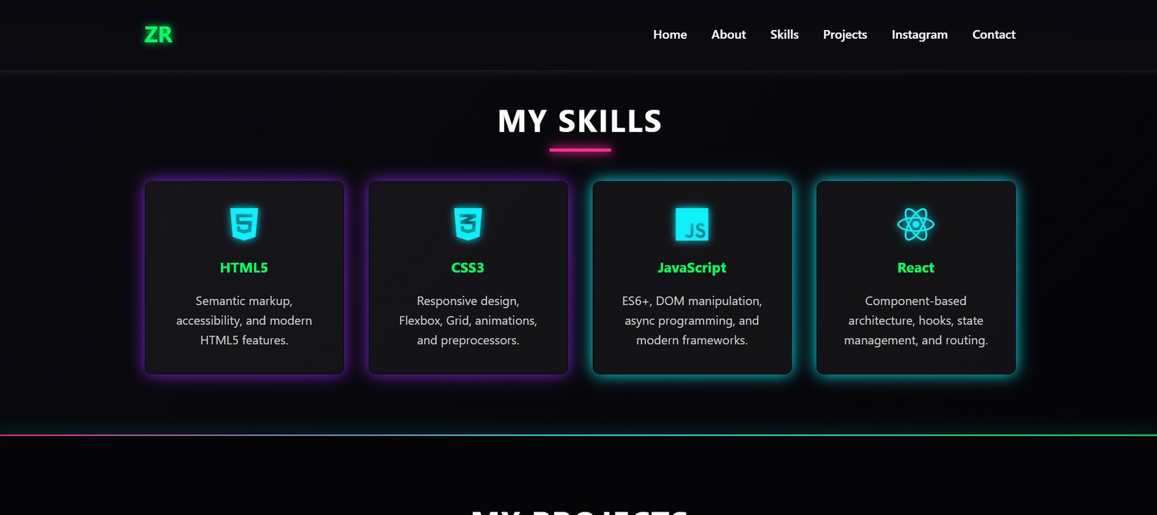
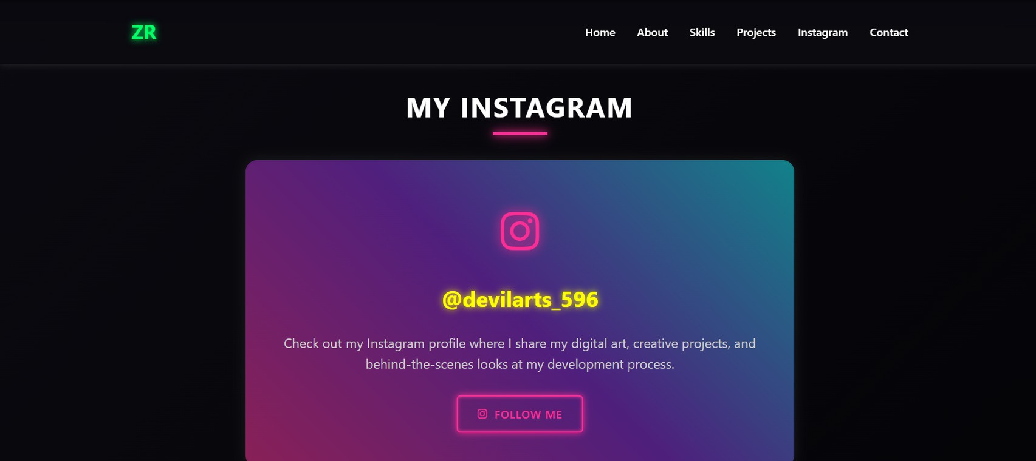

RESULTS AND SCREENSHOTS
3/21/2024 Annual Review
10

Slide 11

CONCLUSION
The portfolio successfully demonstrates Zachariah Roy’s frontend development skills while providing an engaging platform to showcase his work and personality. It highlights both technical expertise and design sense, making it a strong digital presence for professional opportunities.
11

